Slide 1
Group No 16
Tribonacci Matrix Error Control
Supervisor : Bibhas Chandra Dhara Sir
Karan Raj Bagri-001911001036
Swapnil Ghosh-001911001067
Chirag Jaiswal-001911001066
Referred from the research paper ( “TRIBONACCI MATRICES AND A NEW CODING THEORY” ) by MANJUSRI BASU and MONOJIT DAS.

Slide 2
CONTENT
Why Do we need Error Control?
Applications of Tribonacci Coding Matrix
Tribonacci Numbers :
Tribonacci Coding, Decoding Matrix
Some Properties of M^{k} matrix
Tribonacci Coding Theory :
Encoding
Decoding
Error Detection and Correction
Other Methods
Implementation and Analysis:
Error Correction Procedure
Tools used
Issues found
Summary

Slide 3
Why do we need error control?
M
SENDER
RECEIVER
(may receive M’ != M)
Unreliable medium
(may cause corruption of bits in the transmitted message due to attenuation, noise, interference, etc.)

Slide 4
Why do we need error control? (contd.)
To ensure reliable communication over unreliable media, we need to
Be able to detect the corruption when it occurs - Error Detection
Be able to correct the error caused by this corruption, either at the receiver’s end itself (forward error correction) or by asking the sender to send the message again (backward error correction) - Error Correction
The forward corrective ability of the Tribonacci Matrix Coding method is what stands out.

Slide 5
Applications:
A strong corrective ability is important when
transmission error rate is high
propagation delay is high
One such situation is deep space communication.
High propagation delay thanks to large distance between transmitter and receiver.
Between Earth and Mars: 4-21 minutes
Between Earth and Jupiter: 33-53 minutes
Error rates are relatively high too: 10⁻⁶ between Earth and Jupiter.

Slide 6
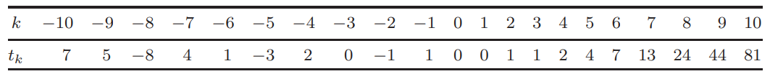
Tribonacci numbers
The Tribonacci numbers t_{k} (k = 0, 1, 2, 3,...) are the generalization of the Fibonacci numbers defined by the recurrence relation

Slide 7
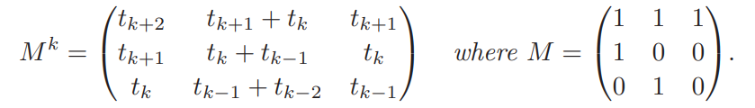
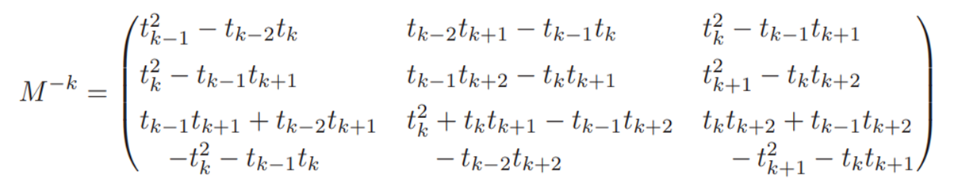
Tribonacci Coding, Decoding Matrix
Tribonacci Matrix / Coding Matrix :
Inverse Of Tribonacci Matrix / Decoding Matrix :

Slide 8
Some Properties of M^{k} Matrix

Slide 9
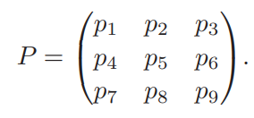
Tribonacci Coding Theory
Message Matrix (P) :
The desired message that we want to send to end-user in the channel.
The message is represented using a matrix of order 3.
All elements of the matrix are non-negative integer.

Slide 10
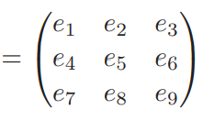

Encoding
This Encoding process is done at sender side.
We are encoding the Message Matrix (P) by multiplying it with the Tribonacci Coding Matrix ( M^{K}).
The encoded matrix is called as Code Matrix (E).

Slide 11
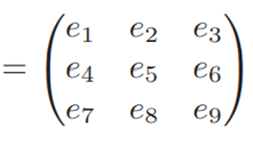
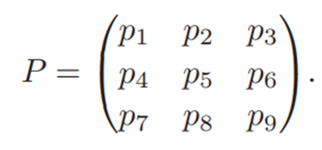


Decoding
This decoding process takes place at receiver side.
We take the Tribonacci Decoding Matrix (M^{-k}) and multiply it with the received Code Matrix (E) .
The decoded matrix is our Message Matrix (P) if and only if there is no error/corruption done in Code Matrix (E), in the transmission channel.

Slide 12
Example
Message
10101100001011111011101011100000010101100010000111111011110000110110011100001001
10101100
00101111
01110101
11000000
10101100
01000011
1111011
11000011
01100111
00001001
Sender Side
Message Matrix
172 | 47 | 117
192 | 67 | 251
195 | 103 | 9
P =
Code Matrix
8
18957 | 15900 | 10298
24673 | 20680 | 13400
20692 | 17376 | 11250
|P| = -1338614
E ( P X M ) =
Tribonacci Coding Matrix
81 | 68 | 44
44 | 37 | 24
24 | 20 | 13
N/W Channel
8
M =
Encoding
01010101,….

Slide 13
Example (cont)
e1 e2 e9
100..
111..
……….
101..
Code Matrix
Receiver Side
N/W Channel
18957 | 15900 | 10298
24673 | 20680 | 13400
20692 | 17376 | 11250
E =
Message Matrix
172 | 47 | 117
192 | 67 | 251
195 | 103 | 9
-8
P ( E X M ) =
Tribonacci Decoding Matrix
1 | -4 | 4
4 | -3 | -8
-8 | 12 | 5
-8
M =
Decoding

Slide 14

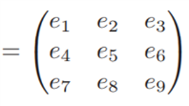

Detection of error in Code Matrix (E)
Sender is sending the Code Matrix (E) and also the determinant of the Message Matrix (P) .
The sole reason for sending determinant of Message Matrix (P) is so that the receiver can verify that the received Code Matrix (E) is error free or not.
,

Slide 15
The error is checked using this relation,
This relation means when that the determinant of the Code Matrix (E) received is equals to the determinant of the Message Matrix (P).
When this relation is holds that means our received Code Matrix (E) is error free otherwise error is present in our Code Matrix (E).

Slide 16
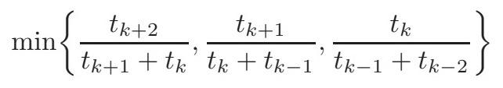




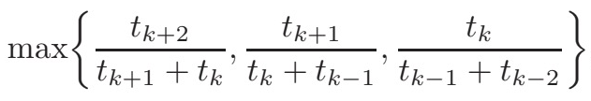
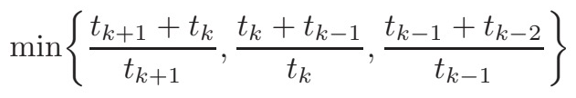



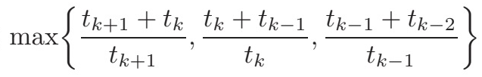
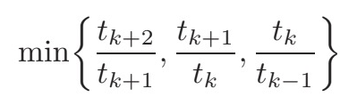



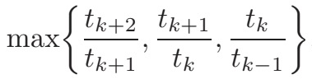
Error Detection and Correction
Detection of error is important as it helps to recover the Code Matrix (E) and eventually the Message Matrix (P).
The inter-relation among the Code Matrix (E) elements are as follows : -

Slide 17
Using the relations mentioned previously we try to correct different folds of error.
We can correct up to 8 folds of error.
We can achieve an accuracy of 99.80 %.
=
0.9980

Slide 18
Other Methods
Cyclic Redundancy Check
In CRC we can only detect error ( all single errors, double errors ) but we cannot correct it, our algorithm can detect error but it’s a bit computationally expensive.
In CRC along with message we also send some extra bits of length maximum degree of message polynomial, but in our algorithm the message size is fixed.
Reed Solomon Code
In RSC we can detect error as well as correct error, just like our algorithm .
Its computationally very expensive at sender side as we use to generate polynomial (p(x)) using Lagrange Interpolation.
Hamming Code
In Hamming Code we can detect and correct only a single bit of error of a binary number, which our algorithm can easily do and it’s computationally less expensive than our algorithm.

Slide 19
IMPLEMENTATION AND ANALYSIS

Slide 20
Error Correction Procedure
Assume a t-fold error (initially t=1).
Choose t entries from the 9 entries in the encoded matrix.
For each such combination:
Let the t elements be variables (effectively assuming that these are the locations of the errors).
Form a constraint satisfaction problem, considering |E| = |P| as well as the ratio ranges mentioned previously.
Use an appropriate solver to solve this problem, only allow for integer solutions.
If a solution is obtained, use it and terminate the procedure.
2. t = t+1
3. if t=9, error can’t be corrected. Terminate the procedure.

Slide 21






TOOLS USED
 | Code editor
 | Programming language
 | For matrix operations, plotting and modelling the error correction problem
Coin-or/Couenne | Solving the error correction problem (minlp)
 | Version Control

Slide 22
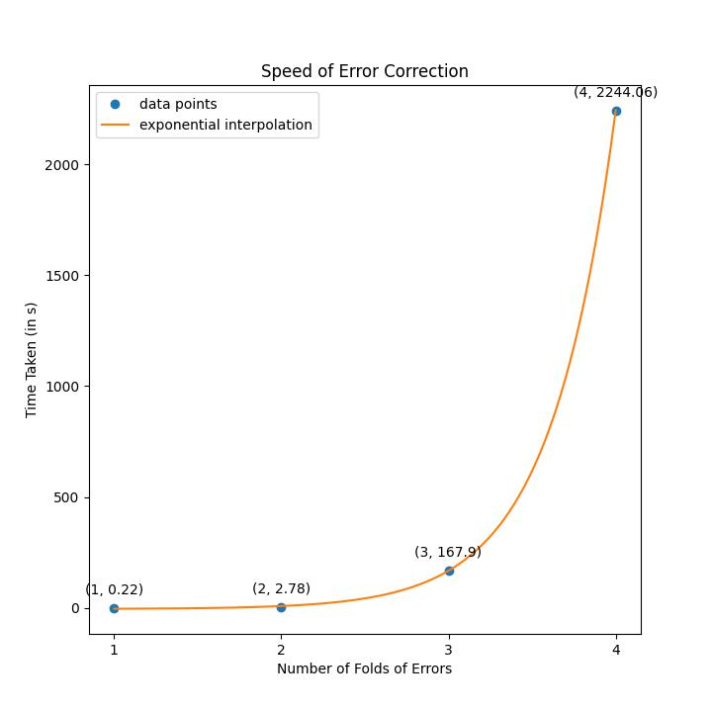
ISSUES:
Time required for error correction increases sharply with increase in the number of folds of error.

Slide 23
ISSUES :
There is a chance (albeit small) that an error will not be detected.
What if E_{received} != E but |E| == |E_{received}| ?
For example,
E =
Here, |E| = |Received| = 421104
Received=
376 345 214
426 284 215
528 352 256
376 345 778
426 284 215
528 352 256

Slide 24
ISSUES :
To inhibit this occurrence:
Also check if the ratios are within bounds, during error detection.
Does not eliminate the problem but reduces the chances significantly.

Slide 25
ISSUES:
There is a chance that the solution given by the solver isn’t the desired one.
Worse when the number of folds of error is high.
Example:
E =
Received=
!= E
34806 29206 18920
84605 71006 45992
71633 60130 38945
34806 29207 18901
34806 29210 18911
Error
84600 52006 41942
Correction
105903 88876 57541
71603 20122 32132
108219 90788 58787

Slide 26
ISSUES :
To inhibit this occurrence:
Increase the value of k (in M^{k}).
When k increases, t_{k+1}/t_{k} stabilizes.
Range of the ratios e1/e3, e2/e3 (and so on) decreases (constraints get tighter).
Solution space gets smaller.
Less chance of obtaining an undesired solution.

Slide 27
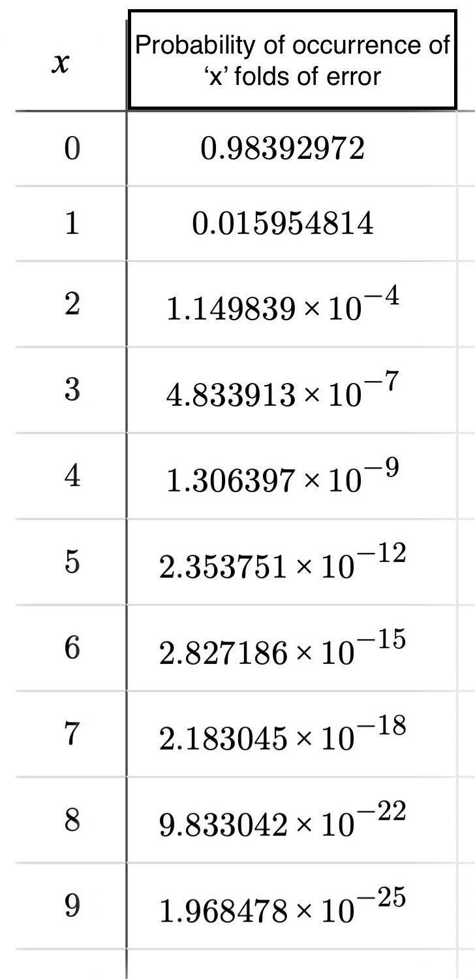
ISSUES:
This method assumes that |P| does not suffer any transmission errors.
Not a good assumption.
Probability that |P| suffers from a transmission error = 2.6 x 10⁻³
N = 8,
k = 10,
ε =10⁻⁴

Slide 28
SUMMARY
Computationally expensive: Matrix operations, MINLP problem.
Too much overhead:
Size of message block = N bits &
k (in M^{k}), then
Number of overhead bits ≈ (0.8k + 2)*9 + (3N+2)
4 inherent issues. Can’t eradicate them, only reach a compromise.
Impractical.
Extra bits in encoded matrix
Number of bits to represent |P|

Slide 29
THANK YOU

